Slide 1

“Text Summarization Web-App”
Mini Project report submitted to
Group Members:
Eshan (215890096)
Abhinav Biswas (215890108)
Under the supervision of
Dr. Raguru Jaya Krishna
Professor
Department of Computer Science and Engineering Manipal Institute of Technology
Bengaluru
Manipal Institute of Technology Bengaluru Campus-560064, Karnataka, India.

Slide 2
Abstract
The code presented in this example demonstrates the implementation of a comprehensive text document retrieval and question-answering system using Pinecone, OpenAI, and Langchain. This system is designed to efficiently index and search through documents related to Manipal University's educational programs. It utilizes a sitemap loader to fetch specific web pages, divides the content into manageable text chunks, and then embeds the text data using OpenAI's language model embeddings. The embedded data is stored and indexed in Pinecone for rapid search and retrieval.
Furthermore, the code leverages a retrieval question-answering (QA) model that integrates OpenAI's language model to provide accurate answers to user queries. The system is designed to return source documents, enabling users to understand the context of the answers provided. This combination of technologies offers a powerful tool for information retrieval and QA in the domain of educational programs and courses.

Slide 3
Contents |  | Page. No.
1 | Introduction………………………………………………….. | 4
2 | Problem Statement…………………………………………... | 5
3 | Objective…………………………………………………….. | 6
4 | Packages used………………………………………………... | 7
5 | Methodology……………………………………………….... | 9
6 | Implementation Details…………………………………….... | 10
7 | Results……………………………………………………….. | 13
8 | Conclusion…………………………………………………... | 15
References…………………………………………………………... |  | 16

Slide 4
Introduction
In the ever-expanding landscape of information, extracting meaningful insights from vast textual data is a formidable challenge. The "Text Summarizer" project emerges as a solution, leveraging advanced Natural Language Processing (NLP) techniques to distill key information and present concise summaries. This project seamlessly integrates popular tools such as spaCy, nlargest, Jumbotron, CSS, HTML, and Flask to create a robust and user-friendly text summarization tool.
With the exponential growth of digital content, the ability to efficiently comprehend and distill information is paramount. The Text Summarizer harnesses the power of spaCy, a leading NLP library, to parse and understand the nuances of text. The nlargest algorithm is employed to identify the most significant sentences, ensuring that the generated summaries capture the essence of the input document.
The user interface is designed for accessibility and aesthetics, employing HTML and CSS to create an engaging and intuitive experience. The Jumbotron component enhances the visual appeal and usability of the application, providing users with a clear and focused platform for text input and summarization.
Powered by Flask, the Text Summarizer extends its functionality to users through a web-based interface. This allows individuals to easily access and utilize the summarization tool from any device with an internet connection. The integration of these technologies results in a dynamic and responsive platform, showcasing the potential of combining NLP and web development for practical applications.

Slide 5
Problem statement
In the context of this code, we aim to build a sophisticated information retrieval and question-answering system for Manipal University's educational programs. The primary challenges and objectives addressed by the code include:
Data Collection: The code retrieves data from the university's website by parsing the sitemap, focusing on specific program-related URLs. However, the efficiency of this data collection process needs to be optimized to handle large and diverse datasets effectively.
Data Preprocessing: The code segments the text content into smaller chunks, a process critical for text embeddings and efficient search. The optimal chunk size and overlap parameters need to be fine-tuned to balance speed and accuracy.
Source Document Retrieval: The code returns source documents along with answers, offering context to users. The system's efficiency in locating and providing these source documents should be optimized.
Overall, the code aims to create an efficient and reliable information retrieval and QA system for educational programs. The challenge lies in optimizing each step of the process, from data collection to question-answering, to provide users with valuable and context-rich information about Manipal University's offerings.

Slide 6
Objectives
bjectives of the Text Summarizer Project:
1. Efficient Information Extraction:
Develop a text summarization tool that utilizes spaCy to efficiently extract key information from large textual datasets, enabling users to obtain concise and relevant summaries.
2. User-Friendly Interface:
Create an intuitive and visually appealing user interface using HTML, CSS, and Jumbotron to enhance the user experience, making the Text Summarizer accessible and engaging for a diverse audience.
3. Automated Summarization Process:
Implement the nlargest algorithm to automate the summarization process, allowing users to generate meaningful summaries without the need for manual intervention, thus saving time and effort.
4. Web-Based Accessibility:
Utilize Flask to deploy the Text Summarizer as a web-based application, ensuring accessibility from various devices with internet connectivity, and facilitating seamless integration into users' workflows.
5. Summarization Accuracy:
Evaluate and enhance the accuracy of the summarization process by continuously refining the spaCy-based NLP model, improving its ability to identify and prioritize key information within the text.

Slide 7
Packages used
spaCy: spaCy is a natural language processing (NLP) library in Python. It provides pre-trained models for various NLP tasks, such as part-of-speech tagging, named entity recognition, and dependency parsing. The library is commonly used for advanced text processing and information extraction.
string: The string module in Python provides a collection of string operations and constants. It is often used for basic string manipulation, formatting, and searching within strings. The module includes functions and constants that make working with text data more convenient.

Slide 8
3.Flask: Flask is a lightweight web application framework for Python. It is designed to be easy to use and flexible, allowing developers to quickly build web applications. Flask provides tools for routing, handling requests and responses, and templating, making it popular for creating web APIs and small to medium-sized web applications.
4.Jumbotron: Jumbotron is not a specific Python package. Instead, it seems to refer to a component in the Bootstrap framework, which is a popular front-end framework for building responsive and visually appealing websites. If you are working with Jumbotron in the context of web development, you may be using Bootstrap along with Flask for creating dynamic web applications.

Slide 9
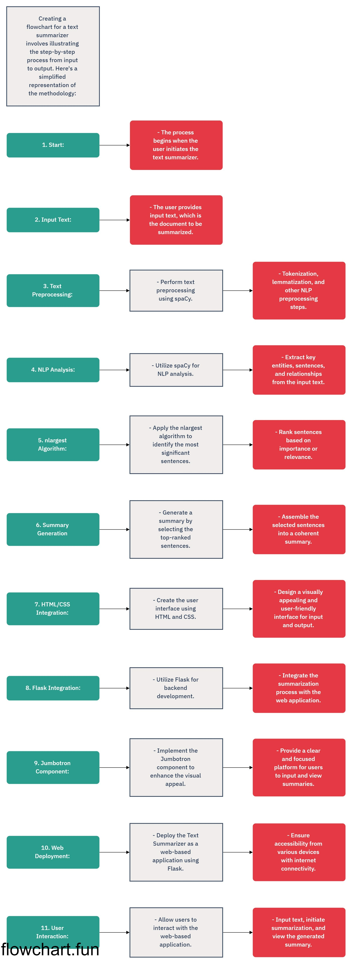
Chapter 5
Methodology
Figure 1

Slide 10
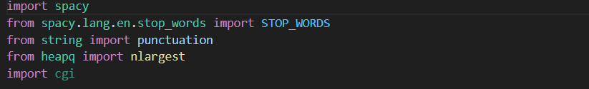
Implementation Details
#Required Repositories:

Slide 11
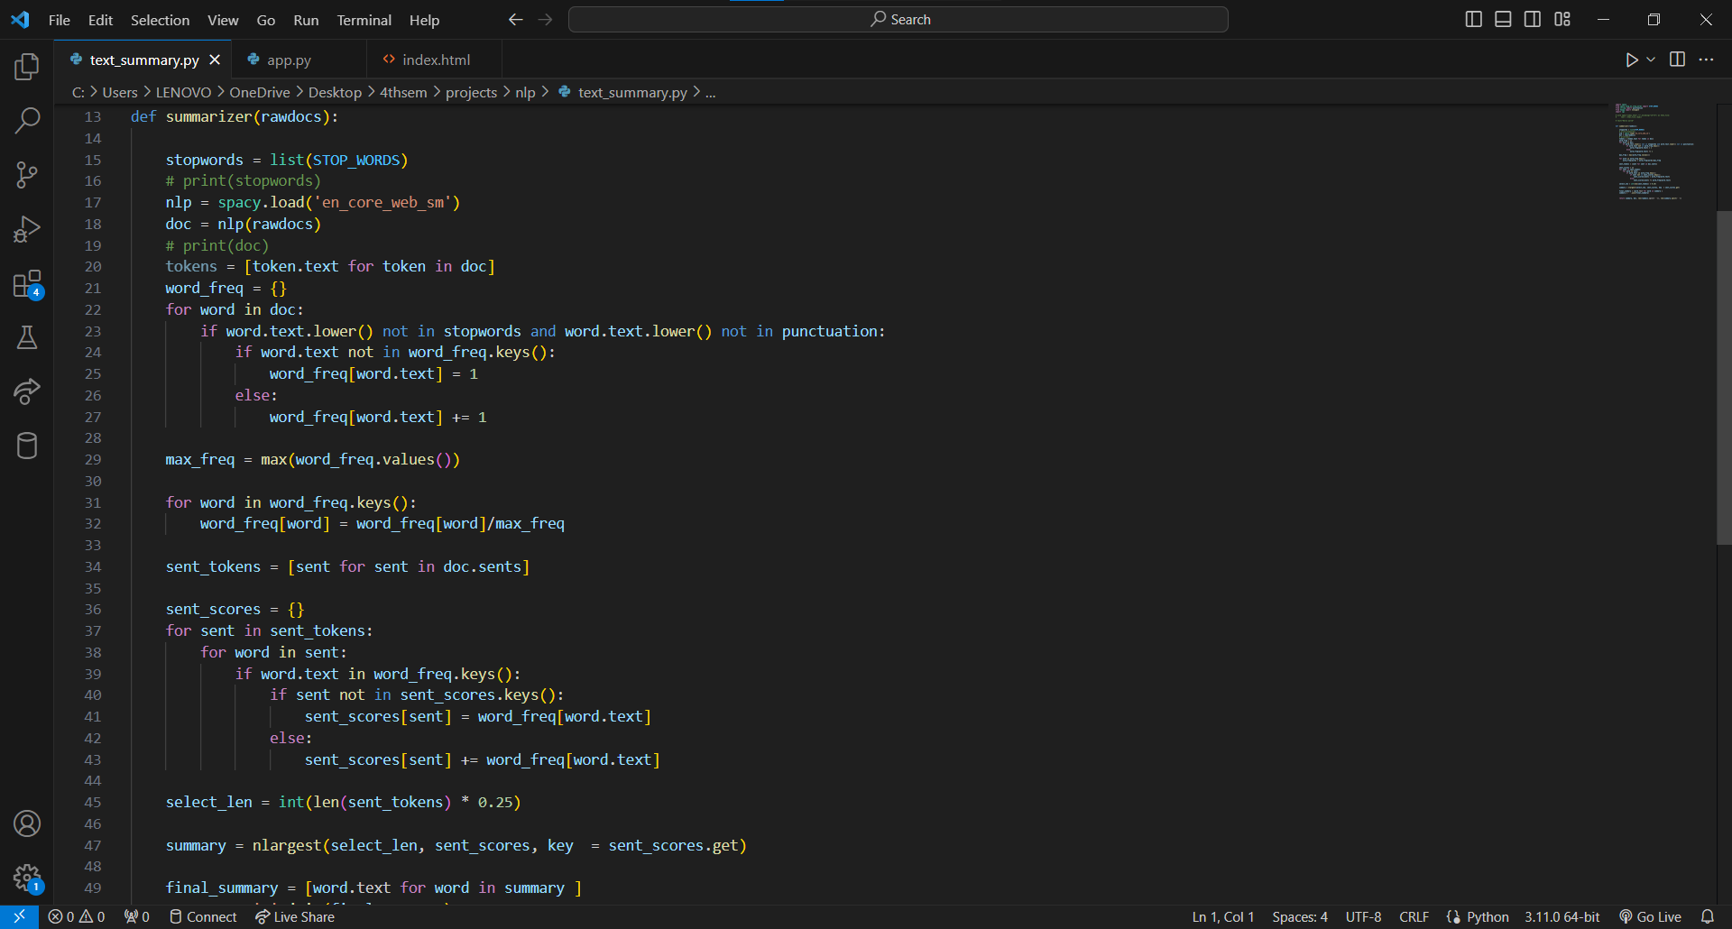
Summarizer Code:

Slide 12
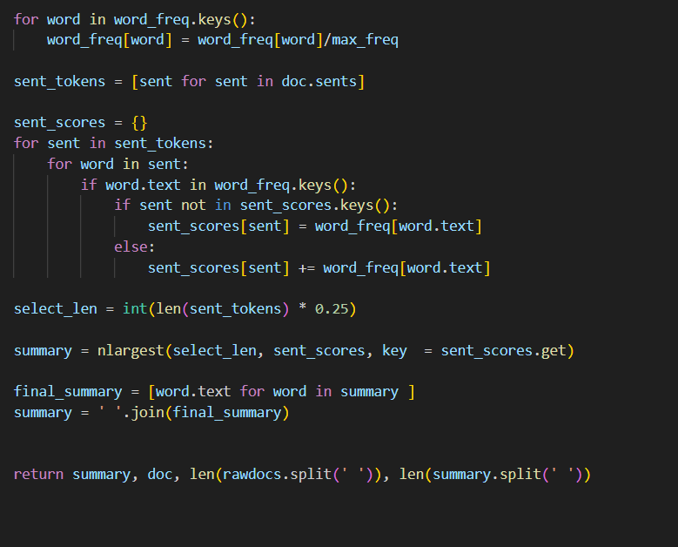
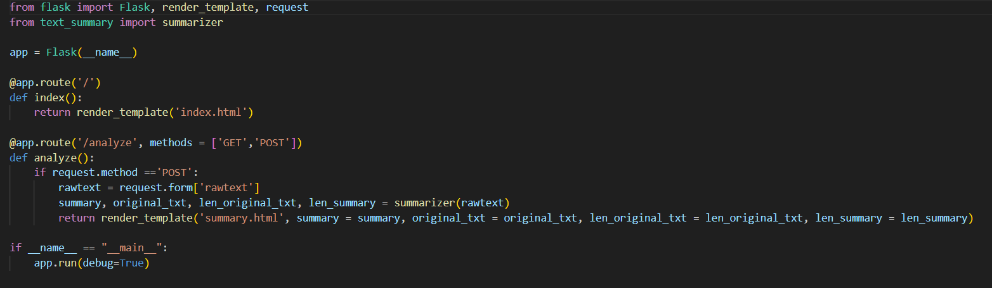
Flask Integration:

Slide 13
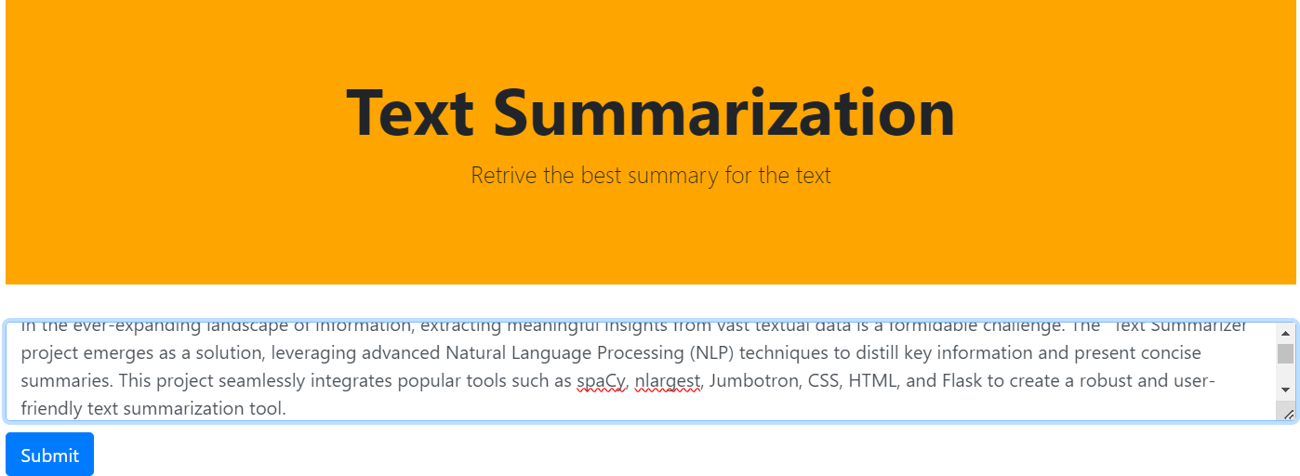
Results

Slide 14
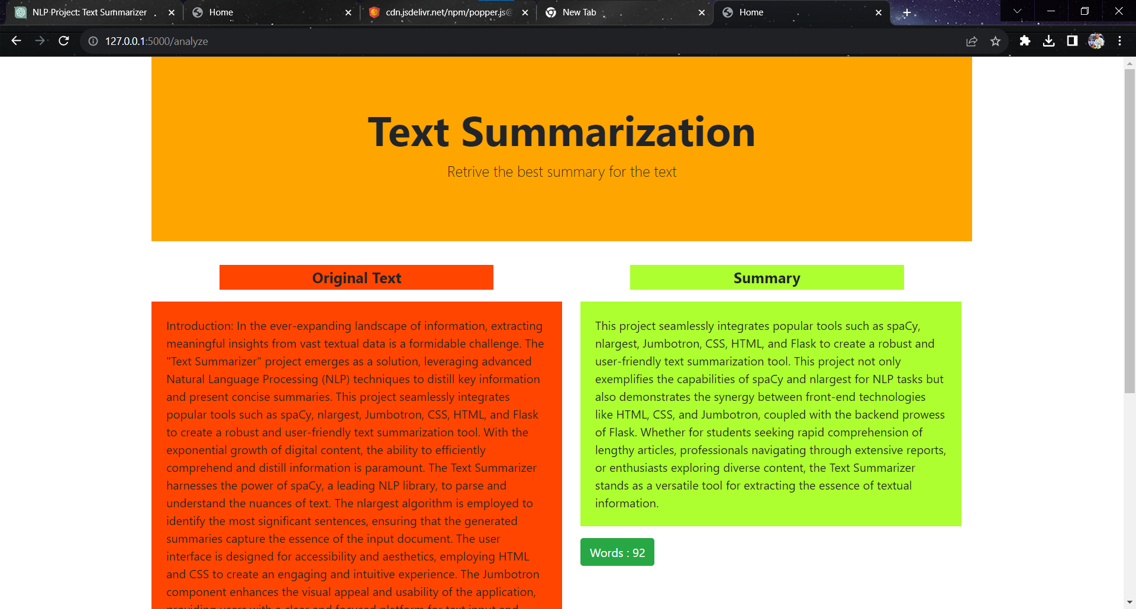

Slide 15
Conclusion
In summary, the Text Summarizer project seamlessly integrates spaCy, nlargest, and Flask to create a robust and user-friendly tool for efficient text summarization. By leveraging advanced NLP techniques, the system automates the summarization process, allowing users to quickly distill key information from extensive textual data. The web-based interface, designed with HTML, CSS, and the Jumbotron component, enhances accessibility and user engagement. The project's commitment to transparency, customization, and error handling further solidifies its practical utility. With the Text Summarizer, users gain a versatile solution for extracting essential insights from diverse documents, making it a valuable asset in the realm of information processing and comprehension.

Slide 16
References
Youtube Tutorial:
https://www.youtube.com/watch?v=ZP0RgW1CKiw
Spacy Documentation: https://spacy.io/api/doc
Flask Documentation: https://flask.palletsprojects.com/en/3.0.x/

